Slide 1
NEO4J CYPHER TUTORIAL WITH PYTHON
Create Neo4j Graph From Multiple Json Files Using Cypher ,Apoc & Python
Tutorial 88

Slide 2
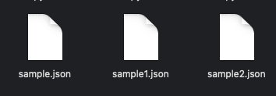
Sample json files

Slide 3
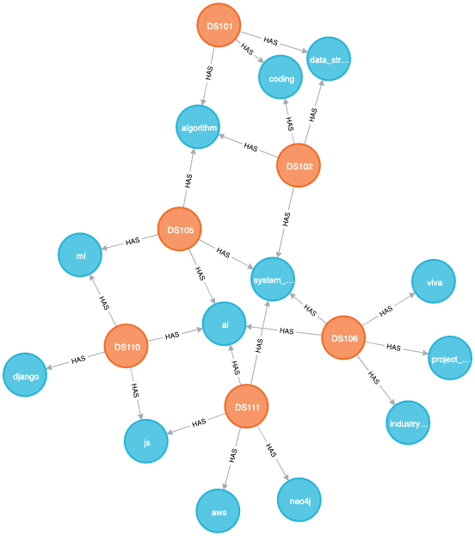
Expected graph

Slide 4
Use case
How To Create Graph From Multiple Json Files In Neo4j Using Cypher using apoc procedure

Slide 5
Pre-requisites
apoc.import.file.enabled=true
apoc.import.file.use_neo4j_config=false

Slide 6
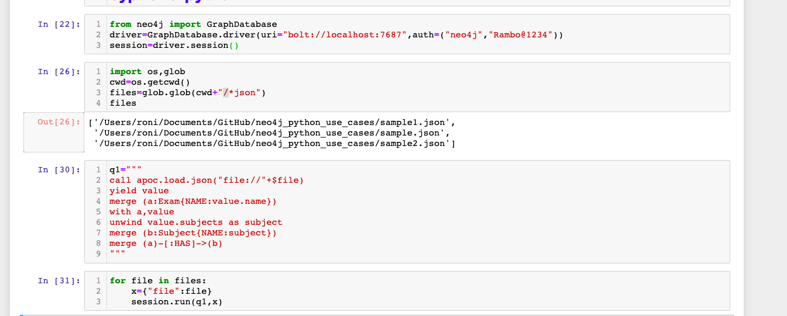
Load multiple csv files using apoc procedures
Code written in python ide

Slide 7
output
From python ide

